Slide 1
README
BURN AFTER READING
about_SlideDeck
The actual presentation starts with slide 6 ("Session title"). The first five slides have a purely organisational purpose. During the break before your session, you should start the presentation with slide 2 ("Next up"), so that the audience knows that they are in the right room. It's fine if you start chatting with the audience during this break, but we need a precise starting point for your presentation in terms of editing your video. That means:
The recording of your presentation will start after the countdown. Please (RE)START talking after the countdown, not during it! Otherwise your recording will start with a half sentence.
It is not necessary to explicitly signal to the PA operator, this is your signal!
Finally, do you have to use this slide deck? No, you are free to present the way you like it. But you are asked to use the intro slides: countdown, session title, sponsor slide. Beyond that, use what is good for the cause – from no slides to sketches from your children, from Jupyter to $youNameIt.
You will find additional information in the notes below.
Sincerely, your hosts!
Dear Speaker, we are thrilled and honored to have you with us in Malmö in 2025. Take your time and read this before you prepare your session.
Since most of you have been with us before, you will already know a lot about PSConfEU. You know that we try to capture all sessions carefully and publish your work on YouTube. There are a few easily avoidable stumbling blocks that we would like to draw your attention to:
Your screen resolution should be 1920x1080 px (FullHD)
You should provide a full size HDMI socket
Mirror your screen
Disable "Presenter View" in PowerPoint
Using MAC or Surface book? Be aware of HDCP!
Disable the ‘Night light mode’
Notes:
The fine print (additional information)
Why should you care about HDCP?
"High-bandwidth Digital Content Protection (HDCP) is a form of digital copy protection developed by Intel Corporation to prevent copying of digital audio and video content as it travels across connections. Types of connections include DisplayPort (DP), Digital Visual Interface (DVI), and High-Definition Multimedia Interface (HDMI), as well as less popular or now deprecated protocols like Gigabit Video Interface (GVIF) and Unified Display Interface (UDI)."
https://en.wikipedia.org/wiki/High-bandwidth_Digital_Content_Protection
Some notebooks ignore the HDCP standard, some vendors comply with the standard. Apple and Microsoft are somehow famous for strictly following the HDCP guidelines. Sadly, we will not be able to guarantee, that your session can be recorded in the latter case.
But you can do simple things, to overcome these problems. It is also very likely that you presented with your notebook before. So you will know, if this worked fine. If you are in doubt and if the agenda allows, try a dry-run a day before and connect everything.
In general you can easily bypass HDCP restrictions with a cheap splitter (the cheaper the better), just like the one you see below. This is an example device that we bought for 16 euros (in Germany).
Ask us, we will lend you such a device.
Thorsten also gave a whole presentation about "Broadcasting yourself" - easy steps to record yourself and create a (backup) session recording on your own. If you want to invest your time and dive deeper, take a look at his recordings and notes:
https://vimeo.com/thorstenbutz/byourself
This is of course completely voluntary, but perhaps you will find it helpful.

Slide 2
Next Up:
Leo D’Arcy
Notes:
Set Screen Resolution to 1080p
Shut down all non-essential applications
Mirror screen to projector
Launch VS Code
Load FireOne Folder
Set VS Code to Light Mode
Plug in and turn on presenter remote
Plug in HDMI Dongle
Presenter View Disable
Set up Presenter remote with 30 mins on it

Slide 3
3
3

Slide 4
2

Slide 5
1

Slide 6
Kinetic PowerShell
Leo D’Arcy
Notes:
Start Timer

Slide 7

Many thanks to our sponsors:

Slide 8
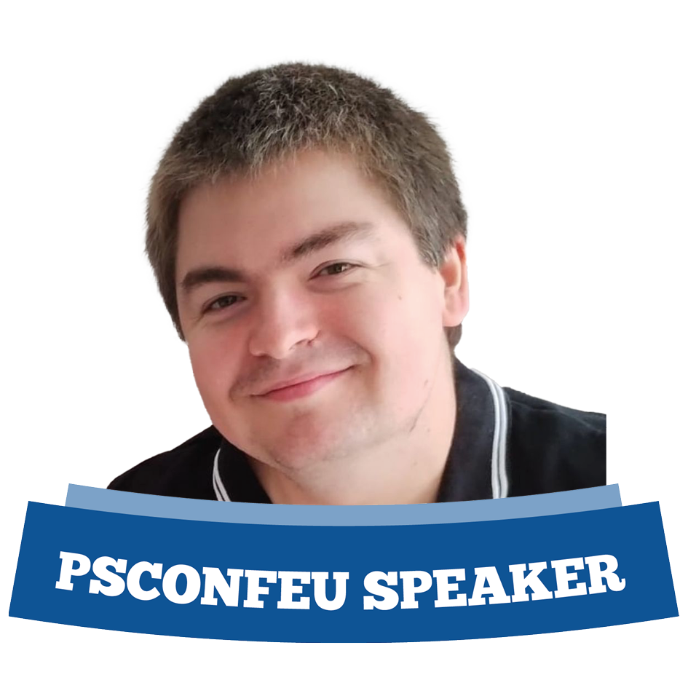
Leo D’Arcy
Microsoft Consultant for 10 Years specializing in:
Azure Datacenter Migrations
Automation
Remote Access Solutions
Currently a Cloud Solutions Architect for a critical issues advisory firm
Pyrotechnician for over 17 years
Notes:
And I love setting off fireworks, A LOT!

Slide 9

Leo D’Arcy
Microsoft Consultant for 10 Years specializing in:
Azure Datacenter Migrations
Automation
Remote Access Solutions
Currently a Cloud Solutions Architect for a critical issues firm
Pyrotechnician for over 17 years

Slide 10
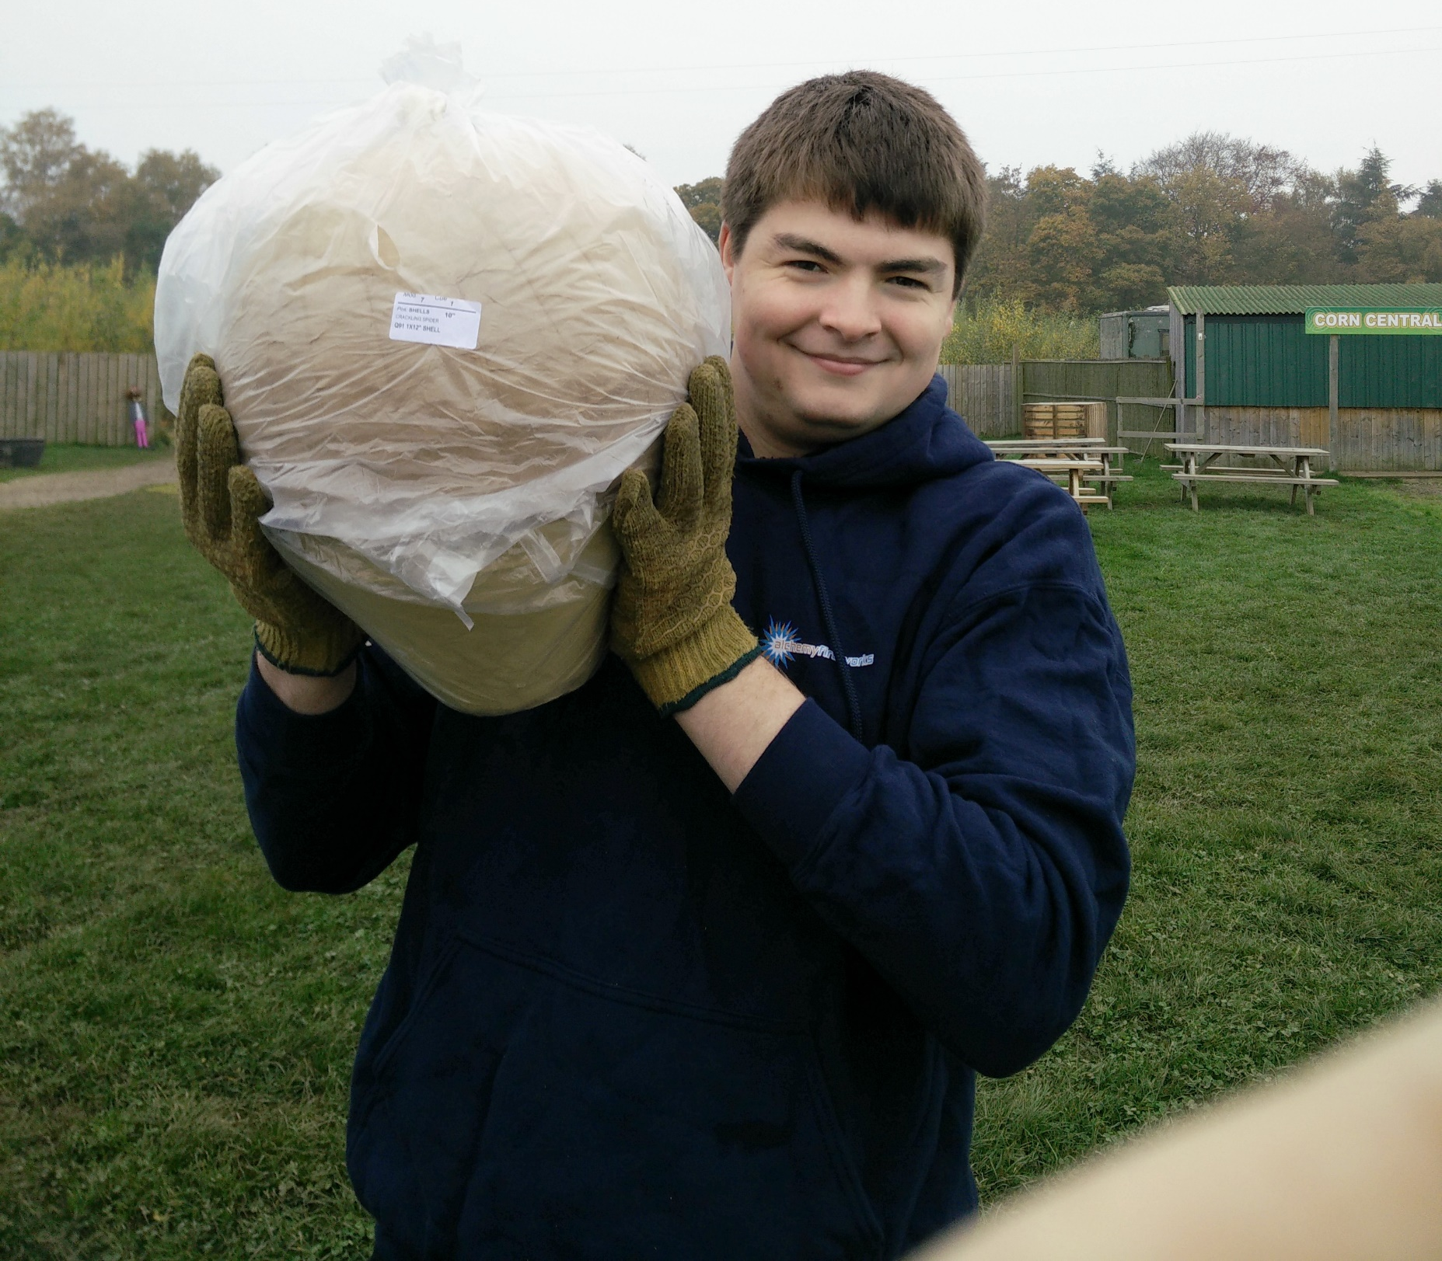
Leo D’Arcy
Microsoft Consultant for 10 Years specializing in:
Azure Datacenter Migrations
Automation
Remote Access Solutions
Currently a Cloud Solutions Architect for a critical issues firm
Pyrotechnician for over 17 years

Slide 11
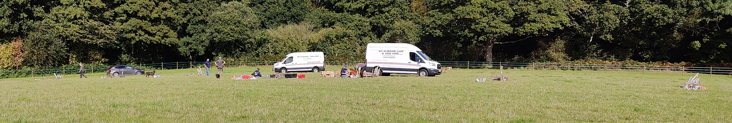
Leo D’Arcy
Microsoft Consultant for 10 Years specializing in:
Azure Datacenter Migrations
Automation
Remote Access Solutions
Currently a Cloud Solutions Architect for a critical issues firm
Pyrotechnician for over 17 years

Slide 12
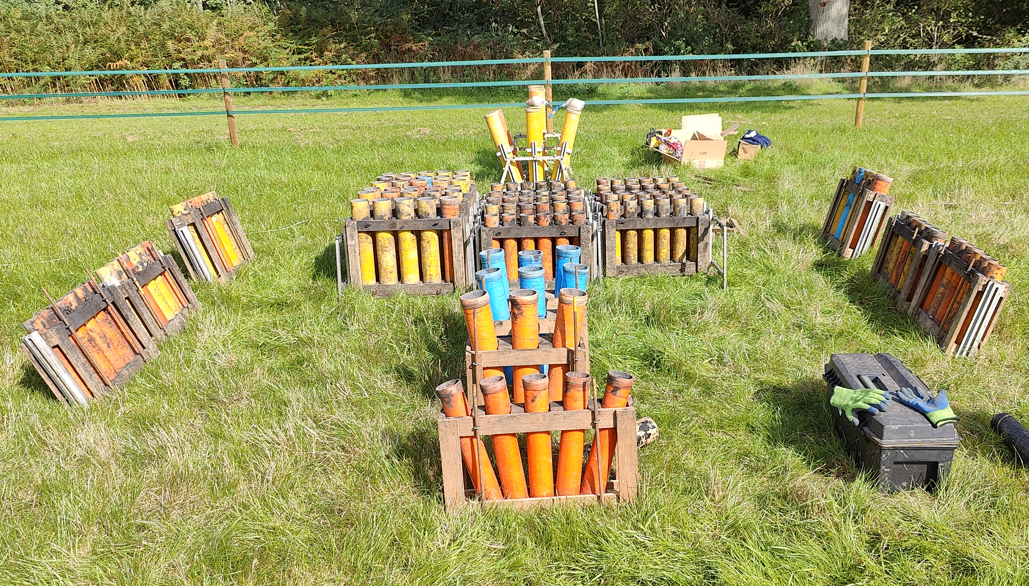
Leo D’Arcy
Microsoft Consultant for 10 Years specializing in:
Azure Datacenter Migrations
Automation
Remote Access Solutions
Currently a Cloud Solutions Architect for a critical issues firm
Pyrotechnician for over 17 years

Slide 13
What am I talking about?

Slide 14
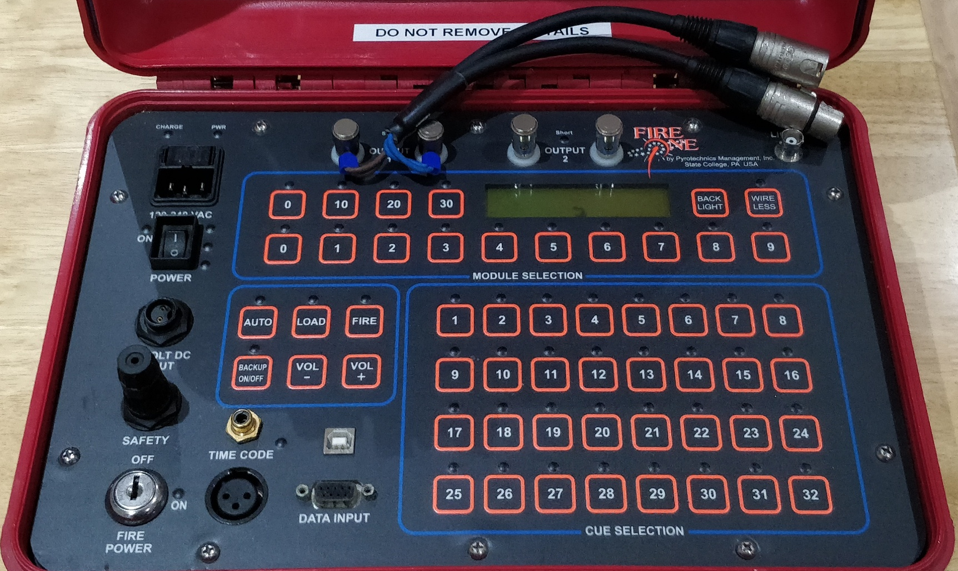
What am I talking about?
Got Curious

Slide 15
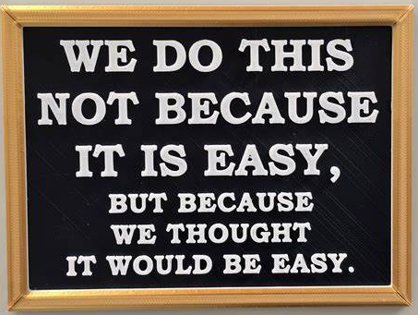
What am I talking about?
Got Curious

Slide 16

What am I talking about?
Got Curious
Built a Module

Slide 17
Aims
Think about the impact of what we do

Slide 18
Aims
Think about the impact of what we do
Share my Love of Fireworks

Slide 19
Aims
Think about the impact of what we do
Share my Love of Fireworks
Show the module design

Slide 20
Aims
Think about the impact of what we do
Share my Love of Fireworks
Show the module design
Touch on Reverse Engineering techniques

Slide 21
Disclaimer
Fireworks are Dangerous
Please be careful!
This talk does not represent the thoughts or opinions of any of my employers
Notes:
No Live demo today ☹

Slide 22
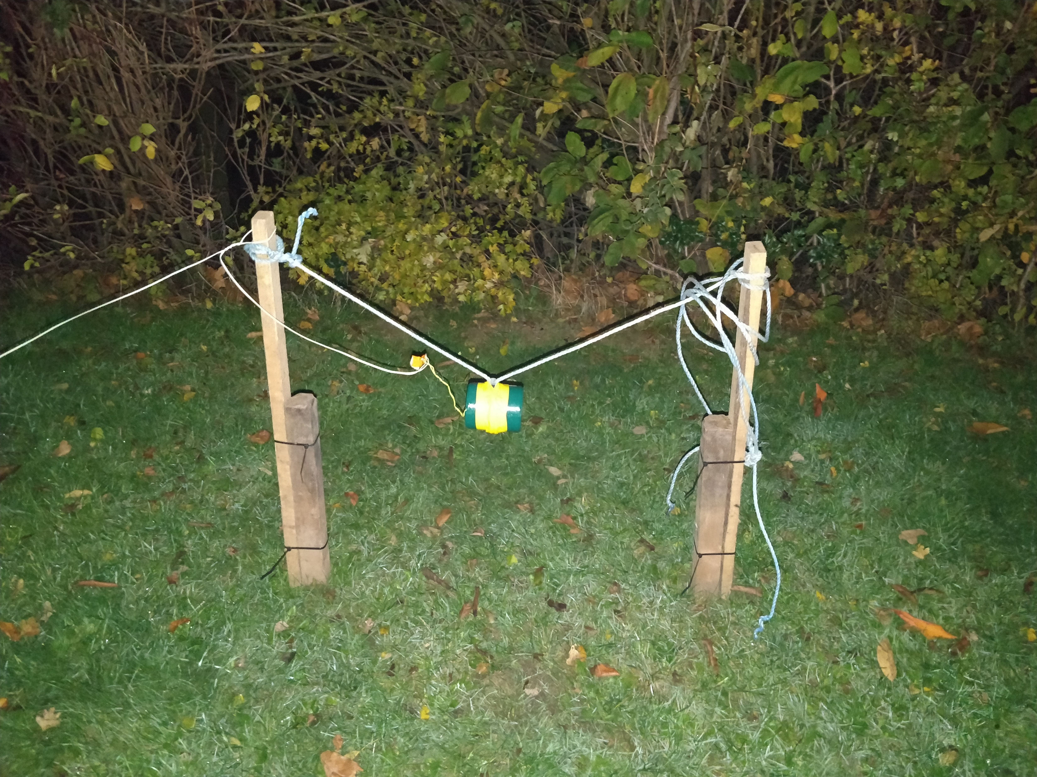
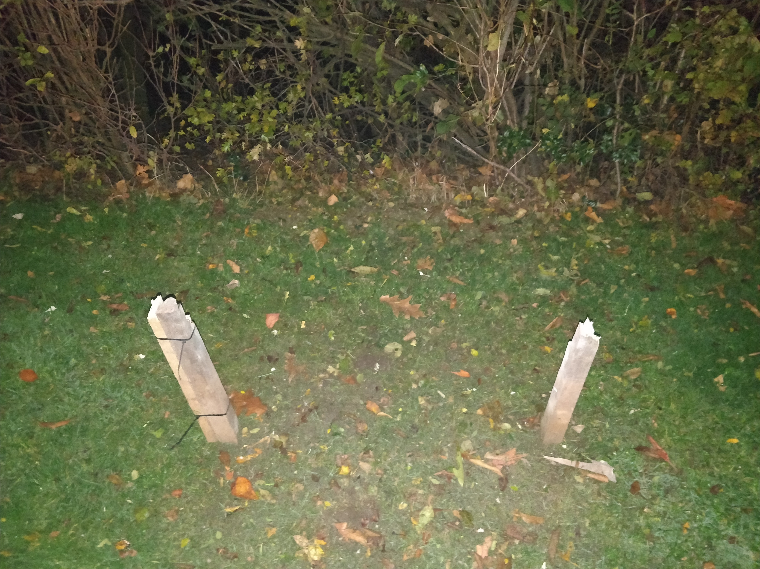
Fireworks are Dangerous

Slide 23
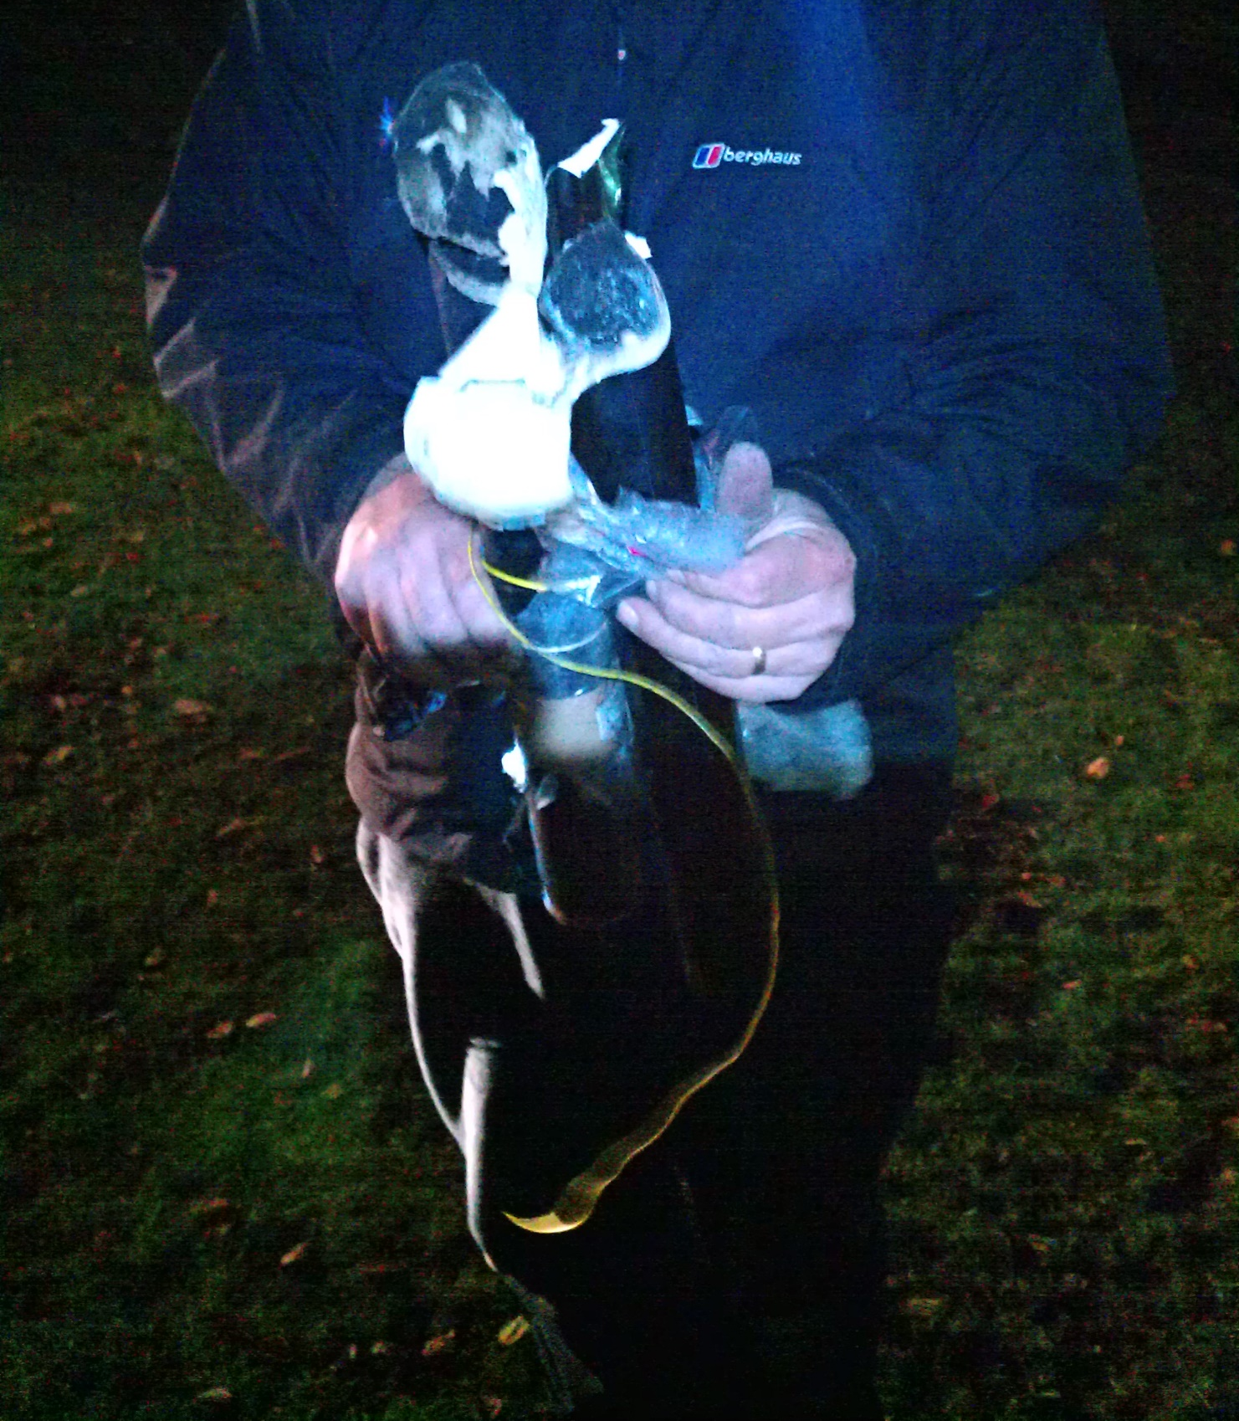
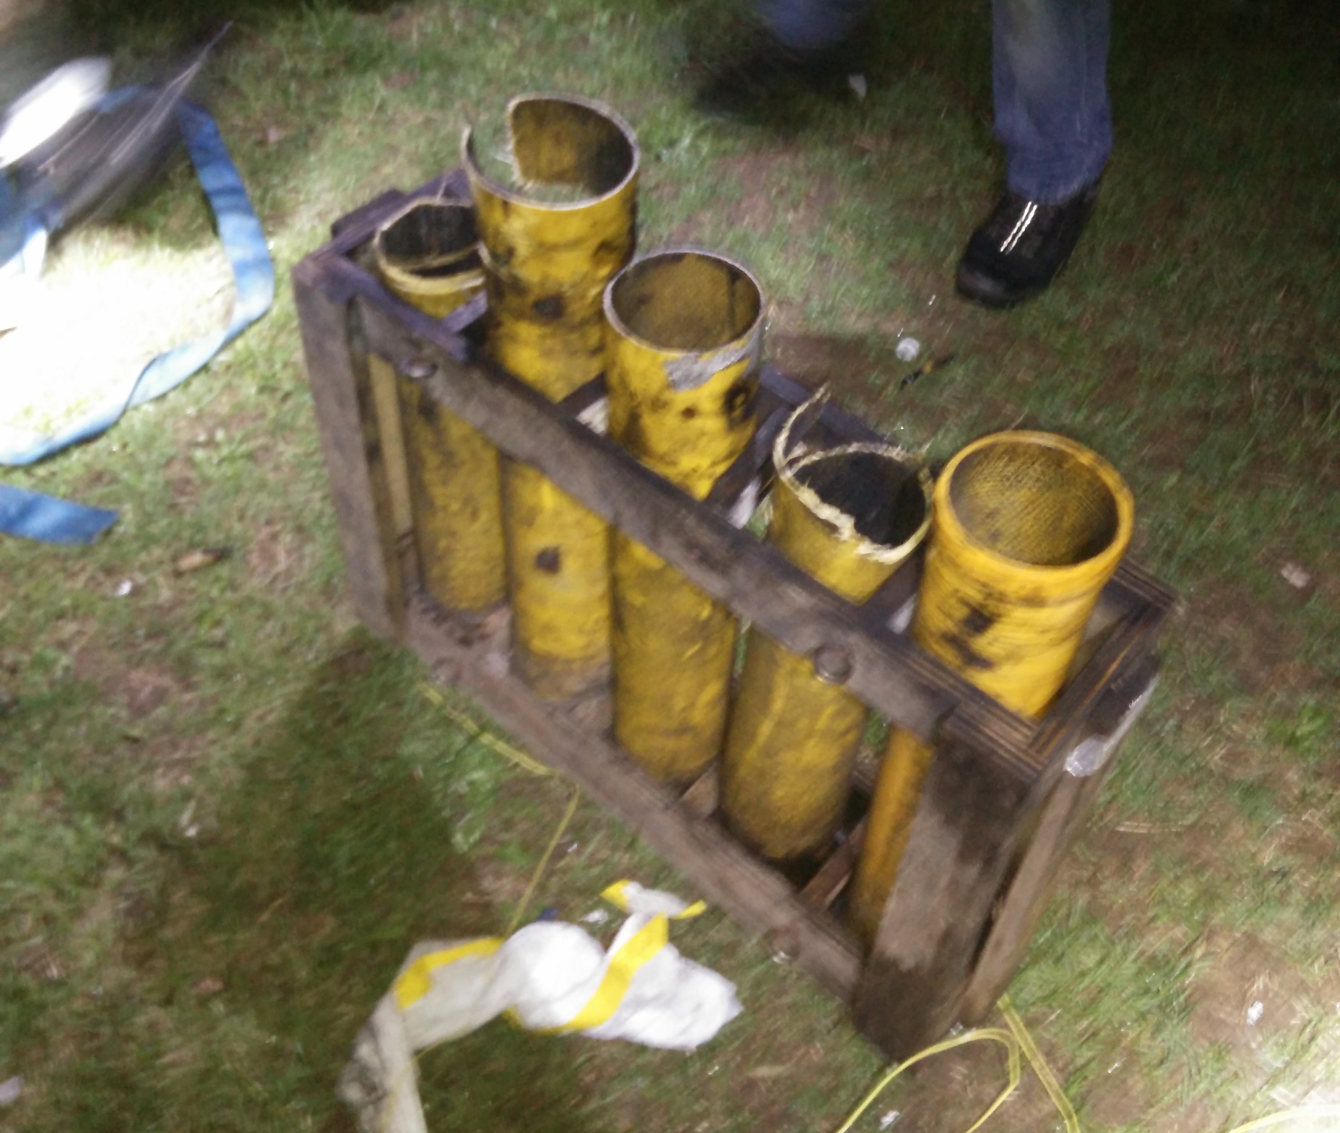
Fireworks are Dangerous

Slide 24
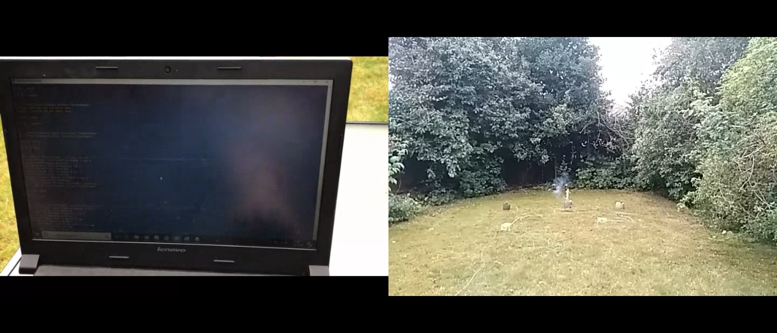
Start with a Bang
Notes:
Starting with a demo of the final setup to give context
Unfortunately no live demo of this bit
Apologies for the poor video quality, it was never intended as a talk
Video is synced between the laptop running the show via PowerShell and the action itself

Slide 25

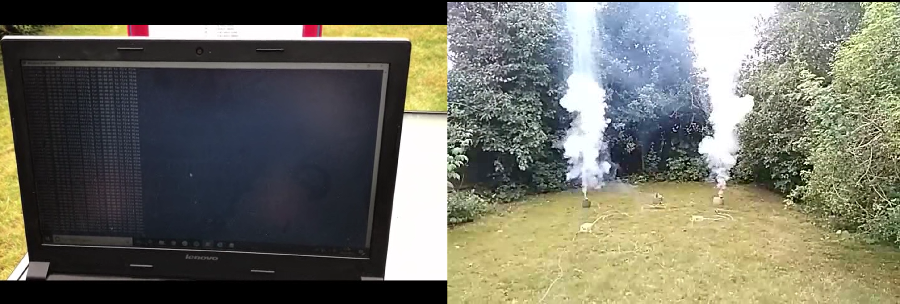
Start with a Bang
Notes:
Starting with a demo of the final setup to give context
Unfortunately no live demo of this bit
Apologies for the poor video quality, it was never intended as a talk
Video is synced between the laptop running the show via PowerShell and the action itself

Slide 26
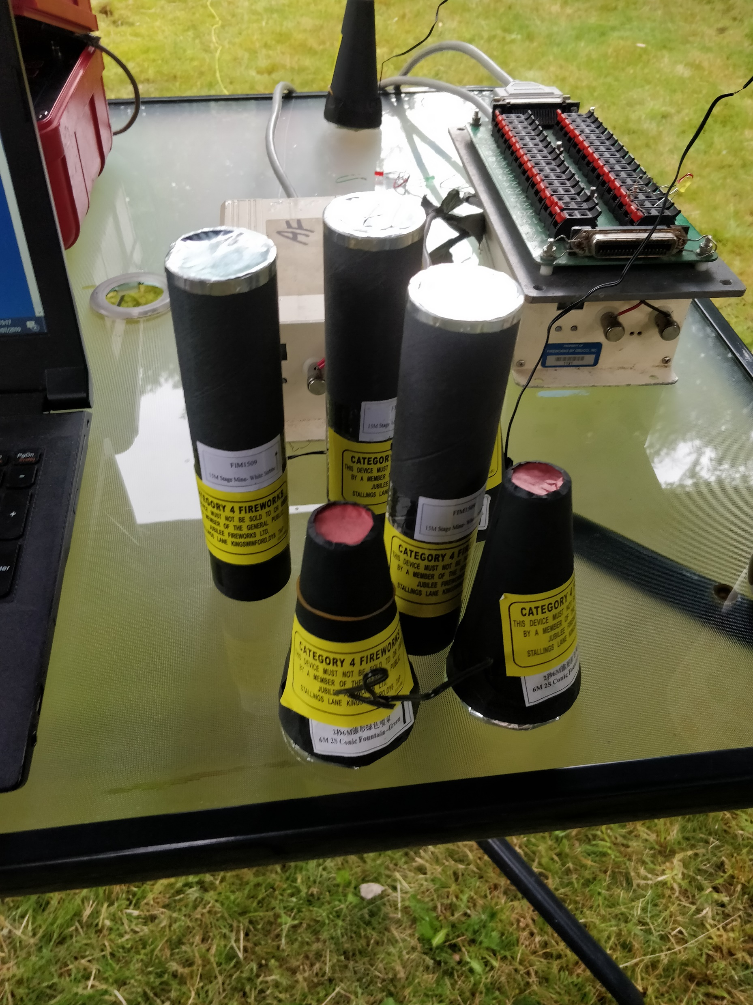
What did we just Watch?
Notes:
Fireworks plug into a module board
Connects to the module control board by Centronics cable
Each module is numbered so you can address fireworks kind of link an IP address
Example shows LEDs and wire loops simulating fireworks for testing

Slide 27
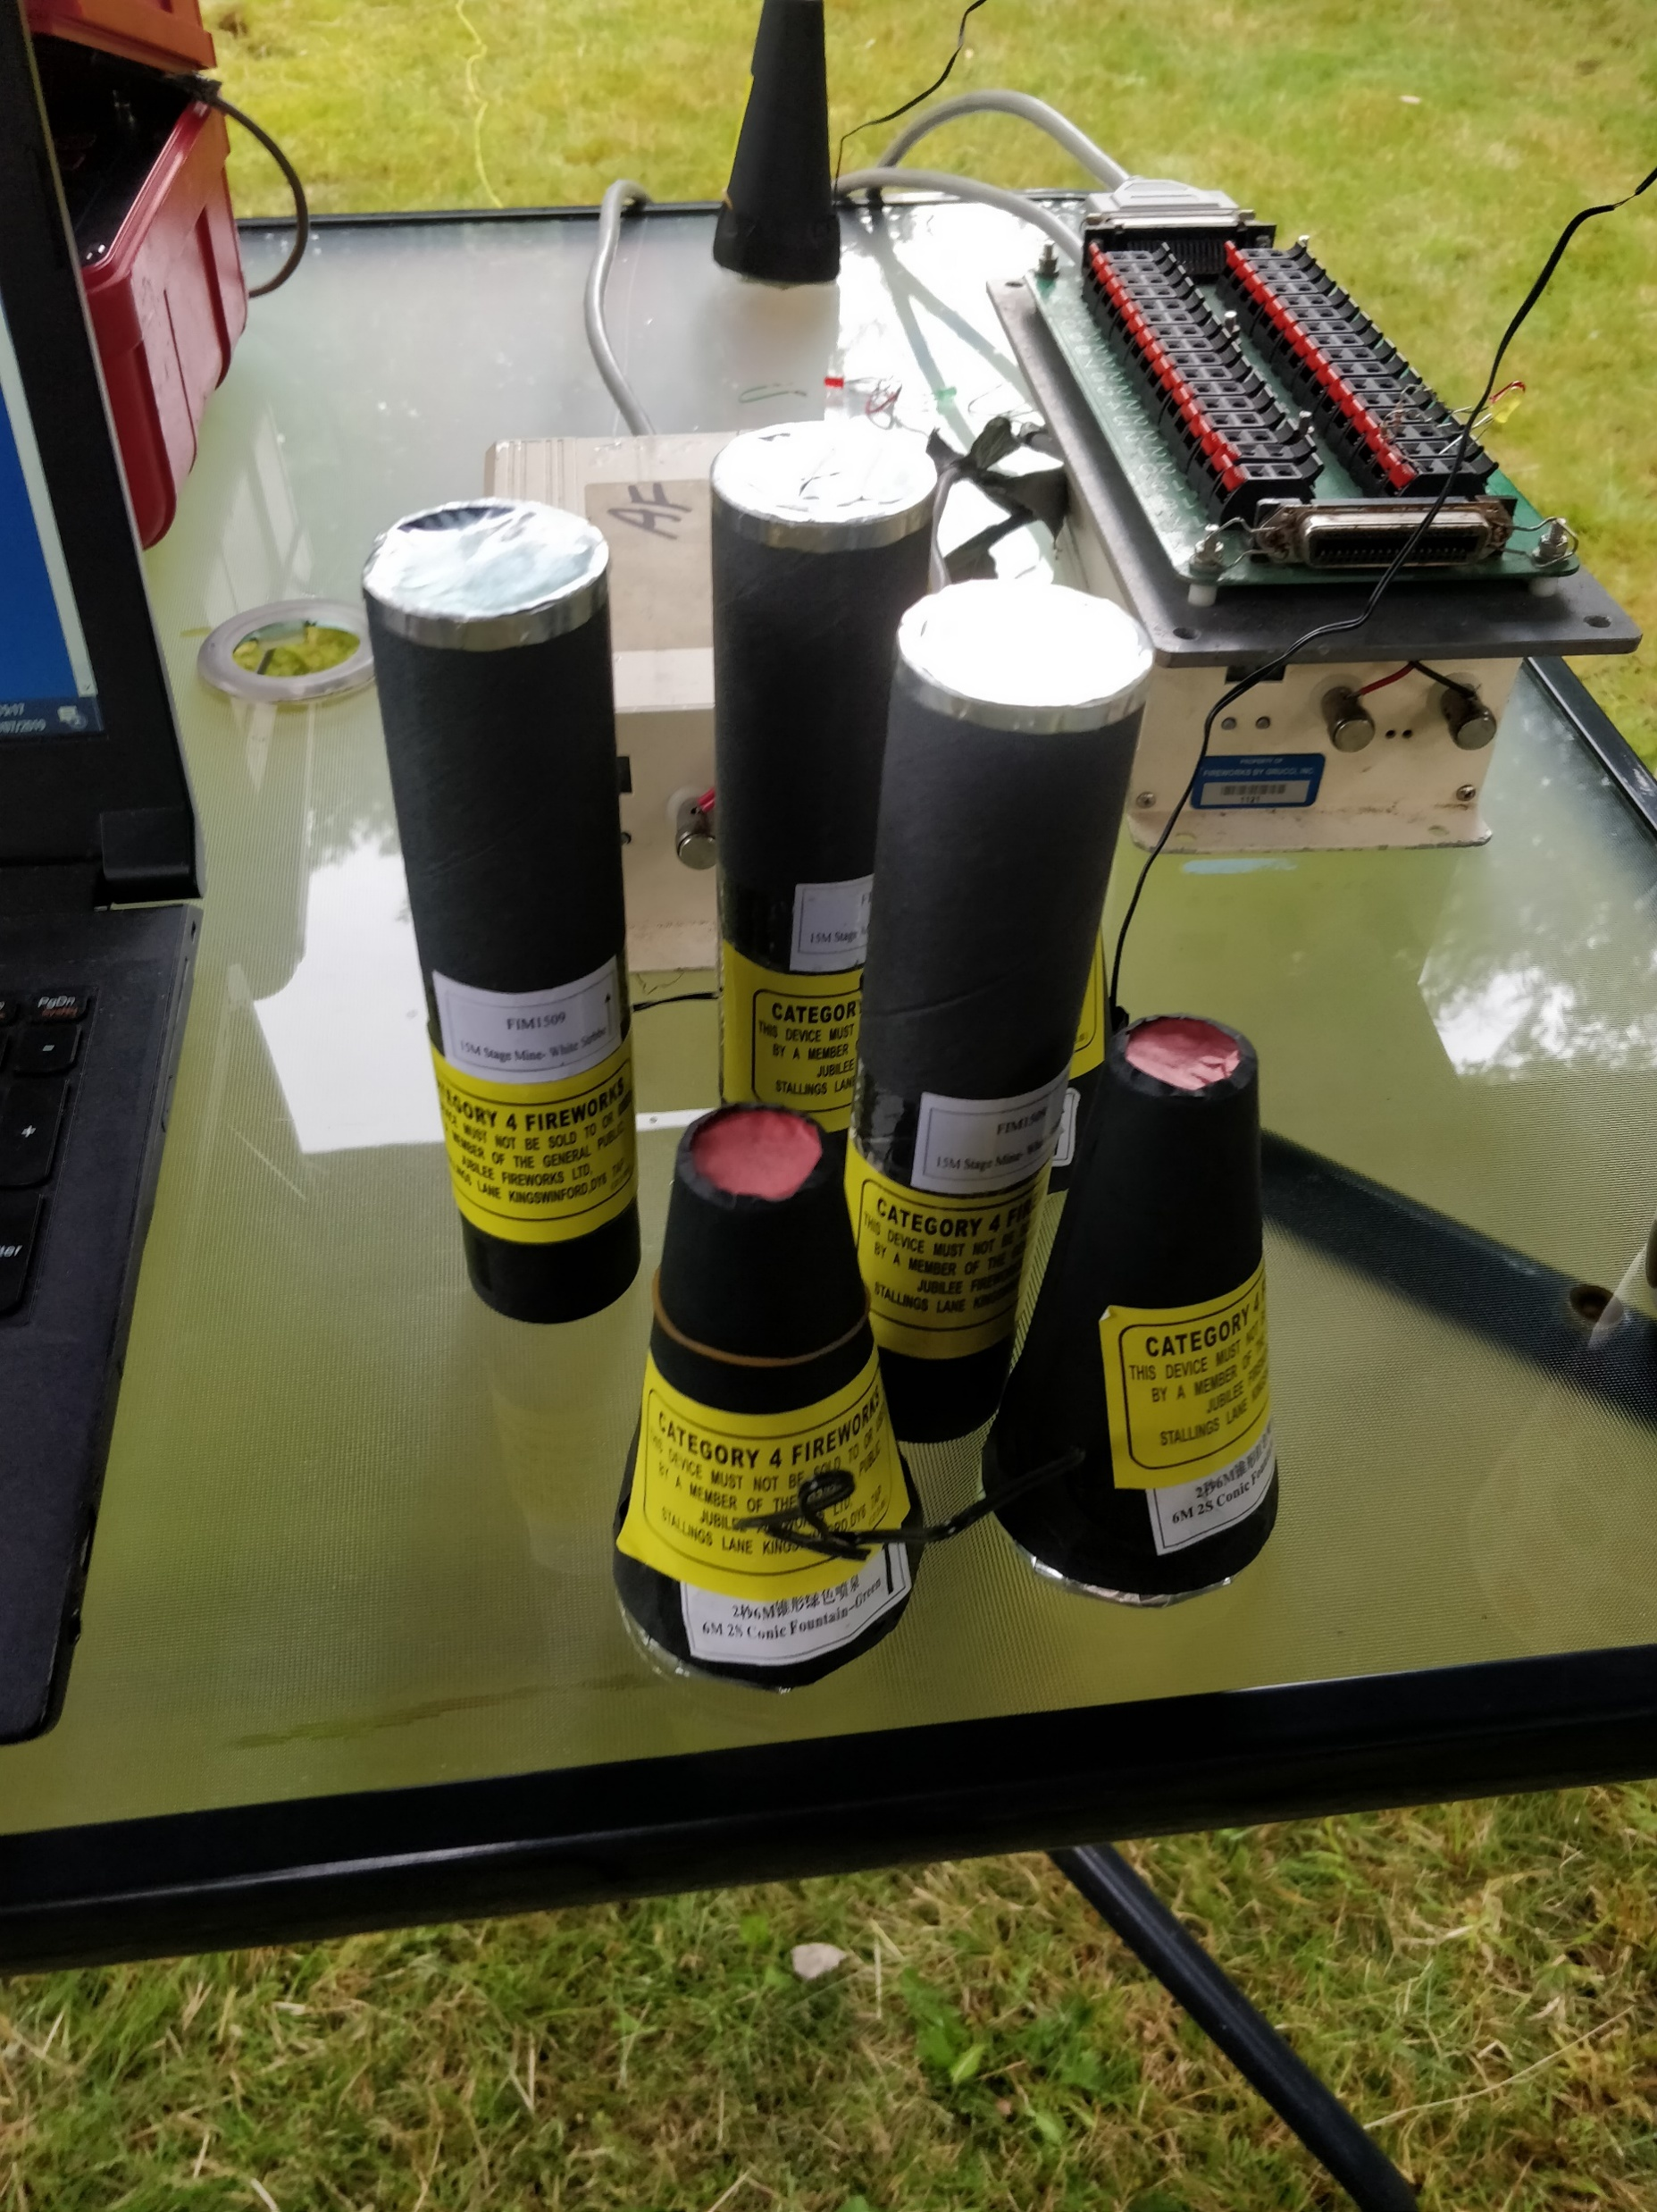
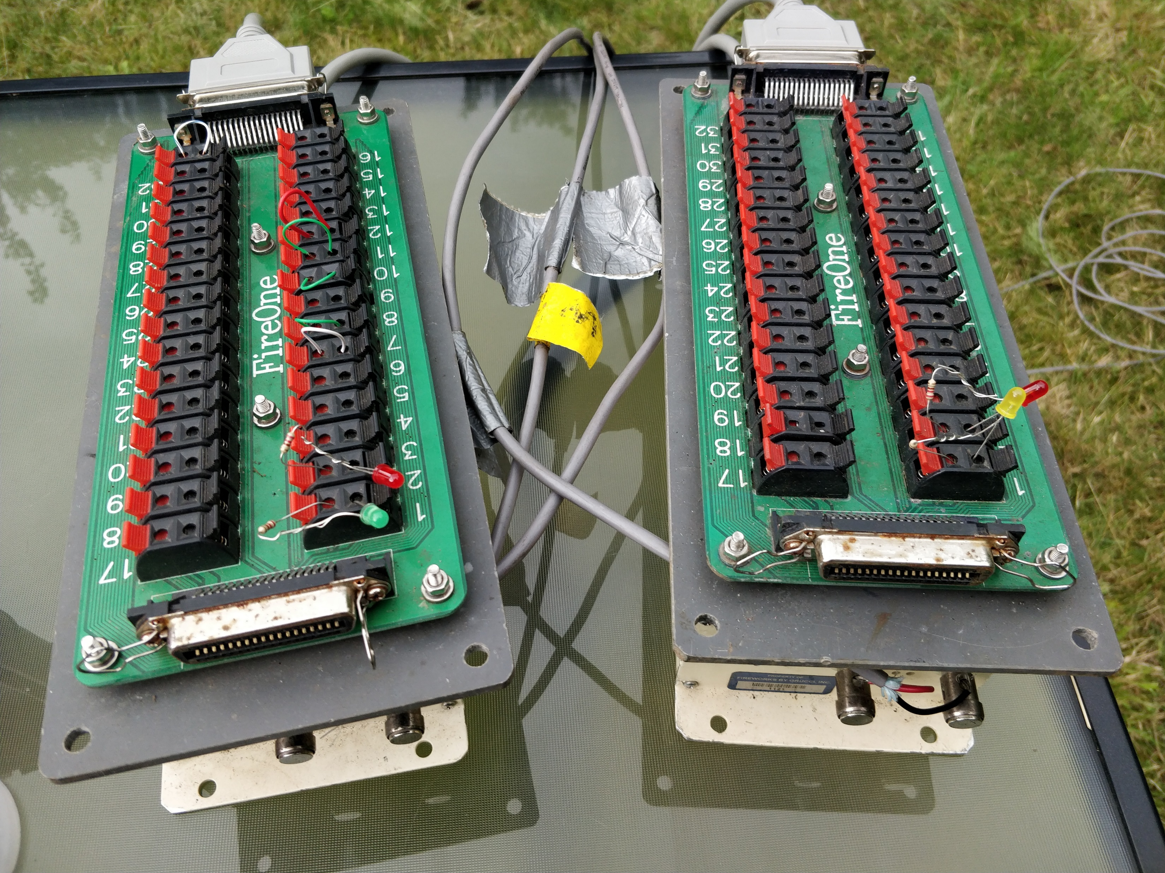
What did we just Watch?
Notes:
Fireworks plug into a module board
Connects to the module control board by Centronics cable
Each module is numbered so you can address fireworks kind of link an IP address
Example shows LEDs and wire loops simulating fireworks for testing

Slide 28
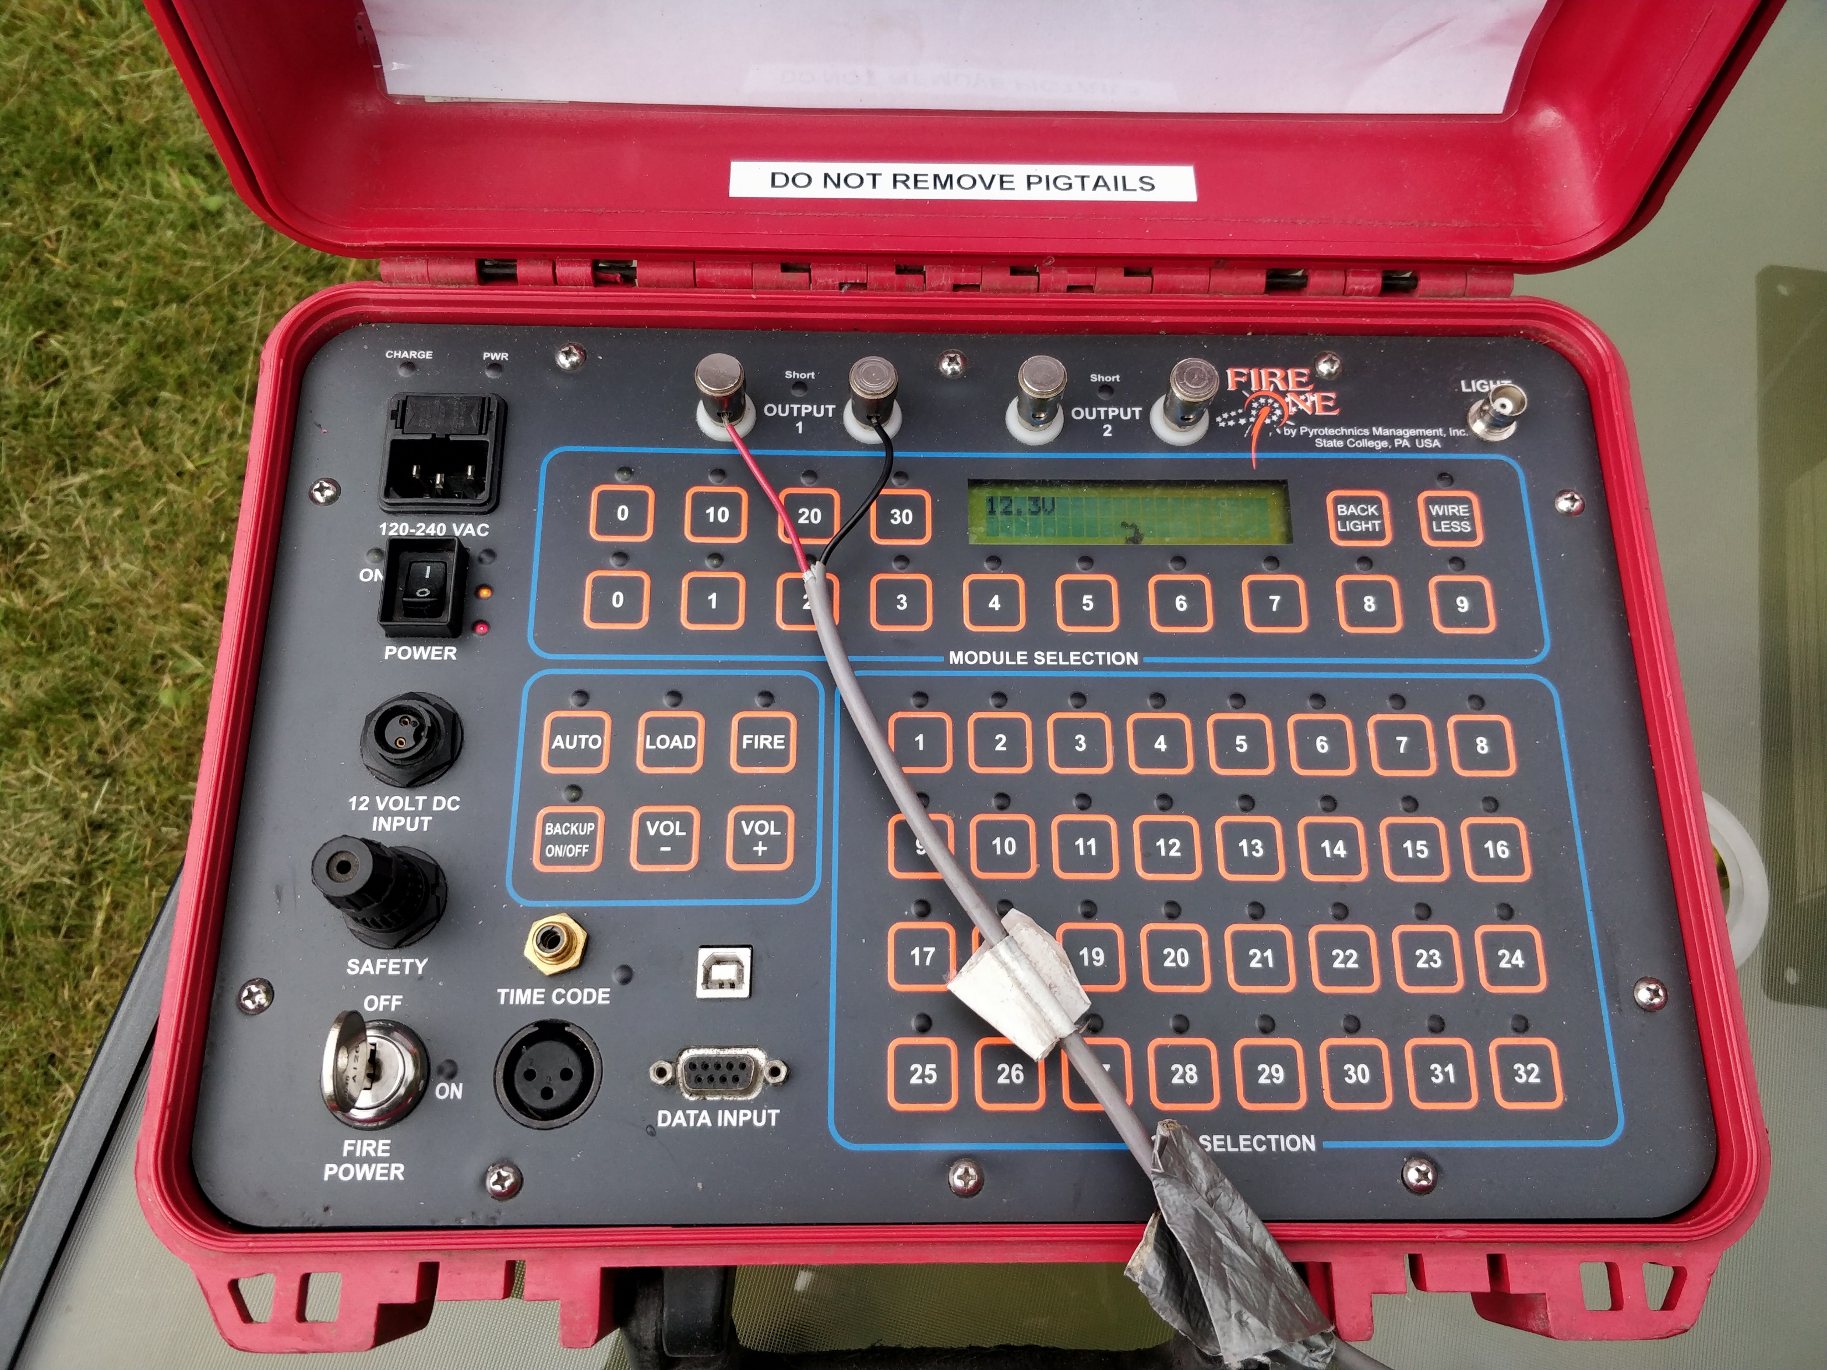
What did we just Watch?
Notes:
Modules connect to Control Module
Normally these are pre-loaded with the programs via USB
Can fire without any additional input

Slide 29
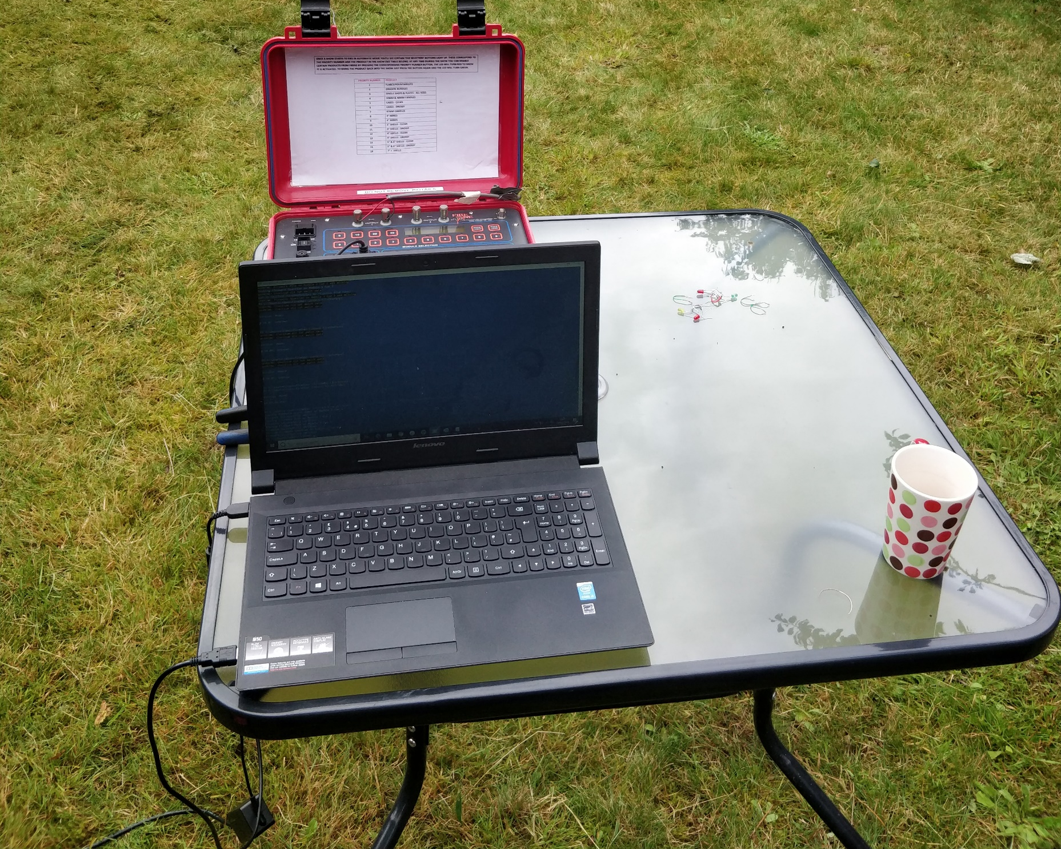
What did we just Watch?
Notes:
Most important: Nice cup of English Breakfast Tea
Laptop connected via USB to Serial Cable
In theory could have used USB to USB but Serial is FAR easier to reverse Engineer

Slide 30
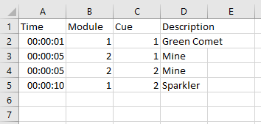
What did we just Watch?
Notes:
Finally
What you didn’t see was the Excel Spreadsheet being used to create the show with timings
Read into PowerShell using the awesome ImportExcel Module (Shout out to Doug Finke)

Slide 31
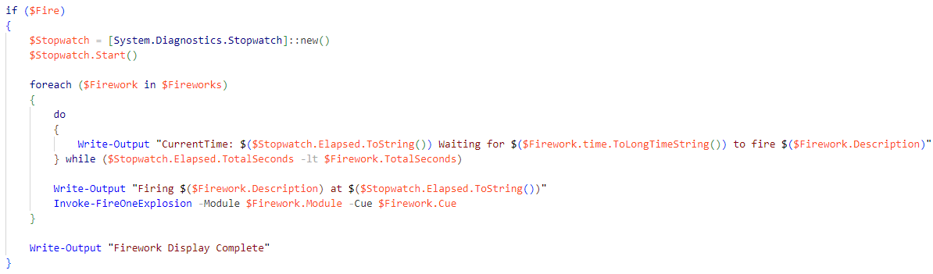
Code Time!
Notes:
Core loop of the Invoke-Show Script
Imports the cues from the Excel Spreadsheet
Checks the data is valid
Runs a test against the FireOne Panel to ensure all Cues exist
Orders the fireworks into time order
Main Loop
Sets up a high accuracy timer
As there is an ordered list we can simply check if the current firework needs to fire
Works fast enough for simultaneous shots
When ready calls the Panel to ignite the firework

Slide 32
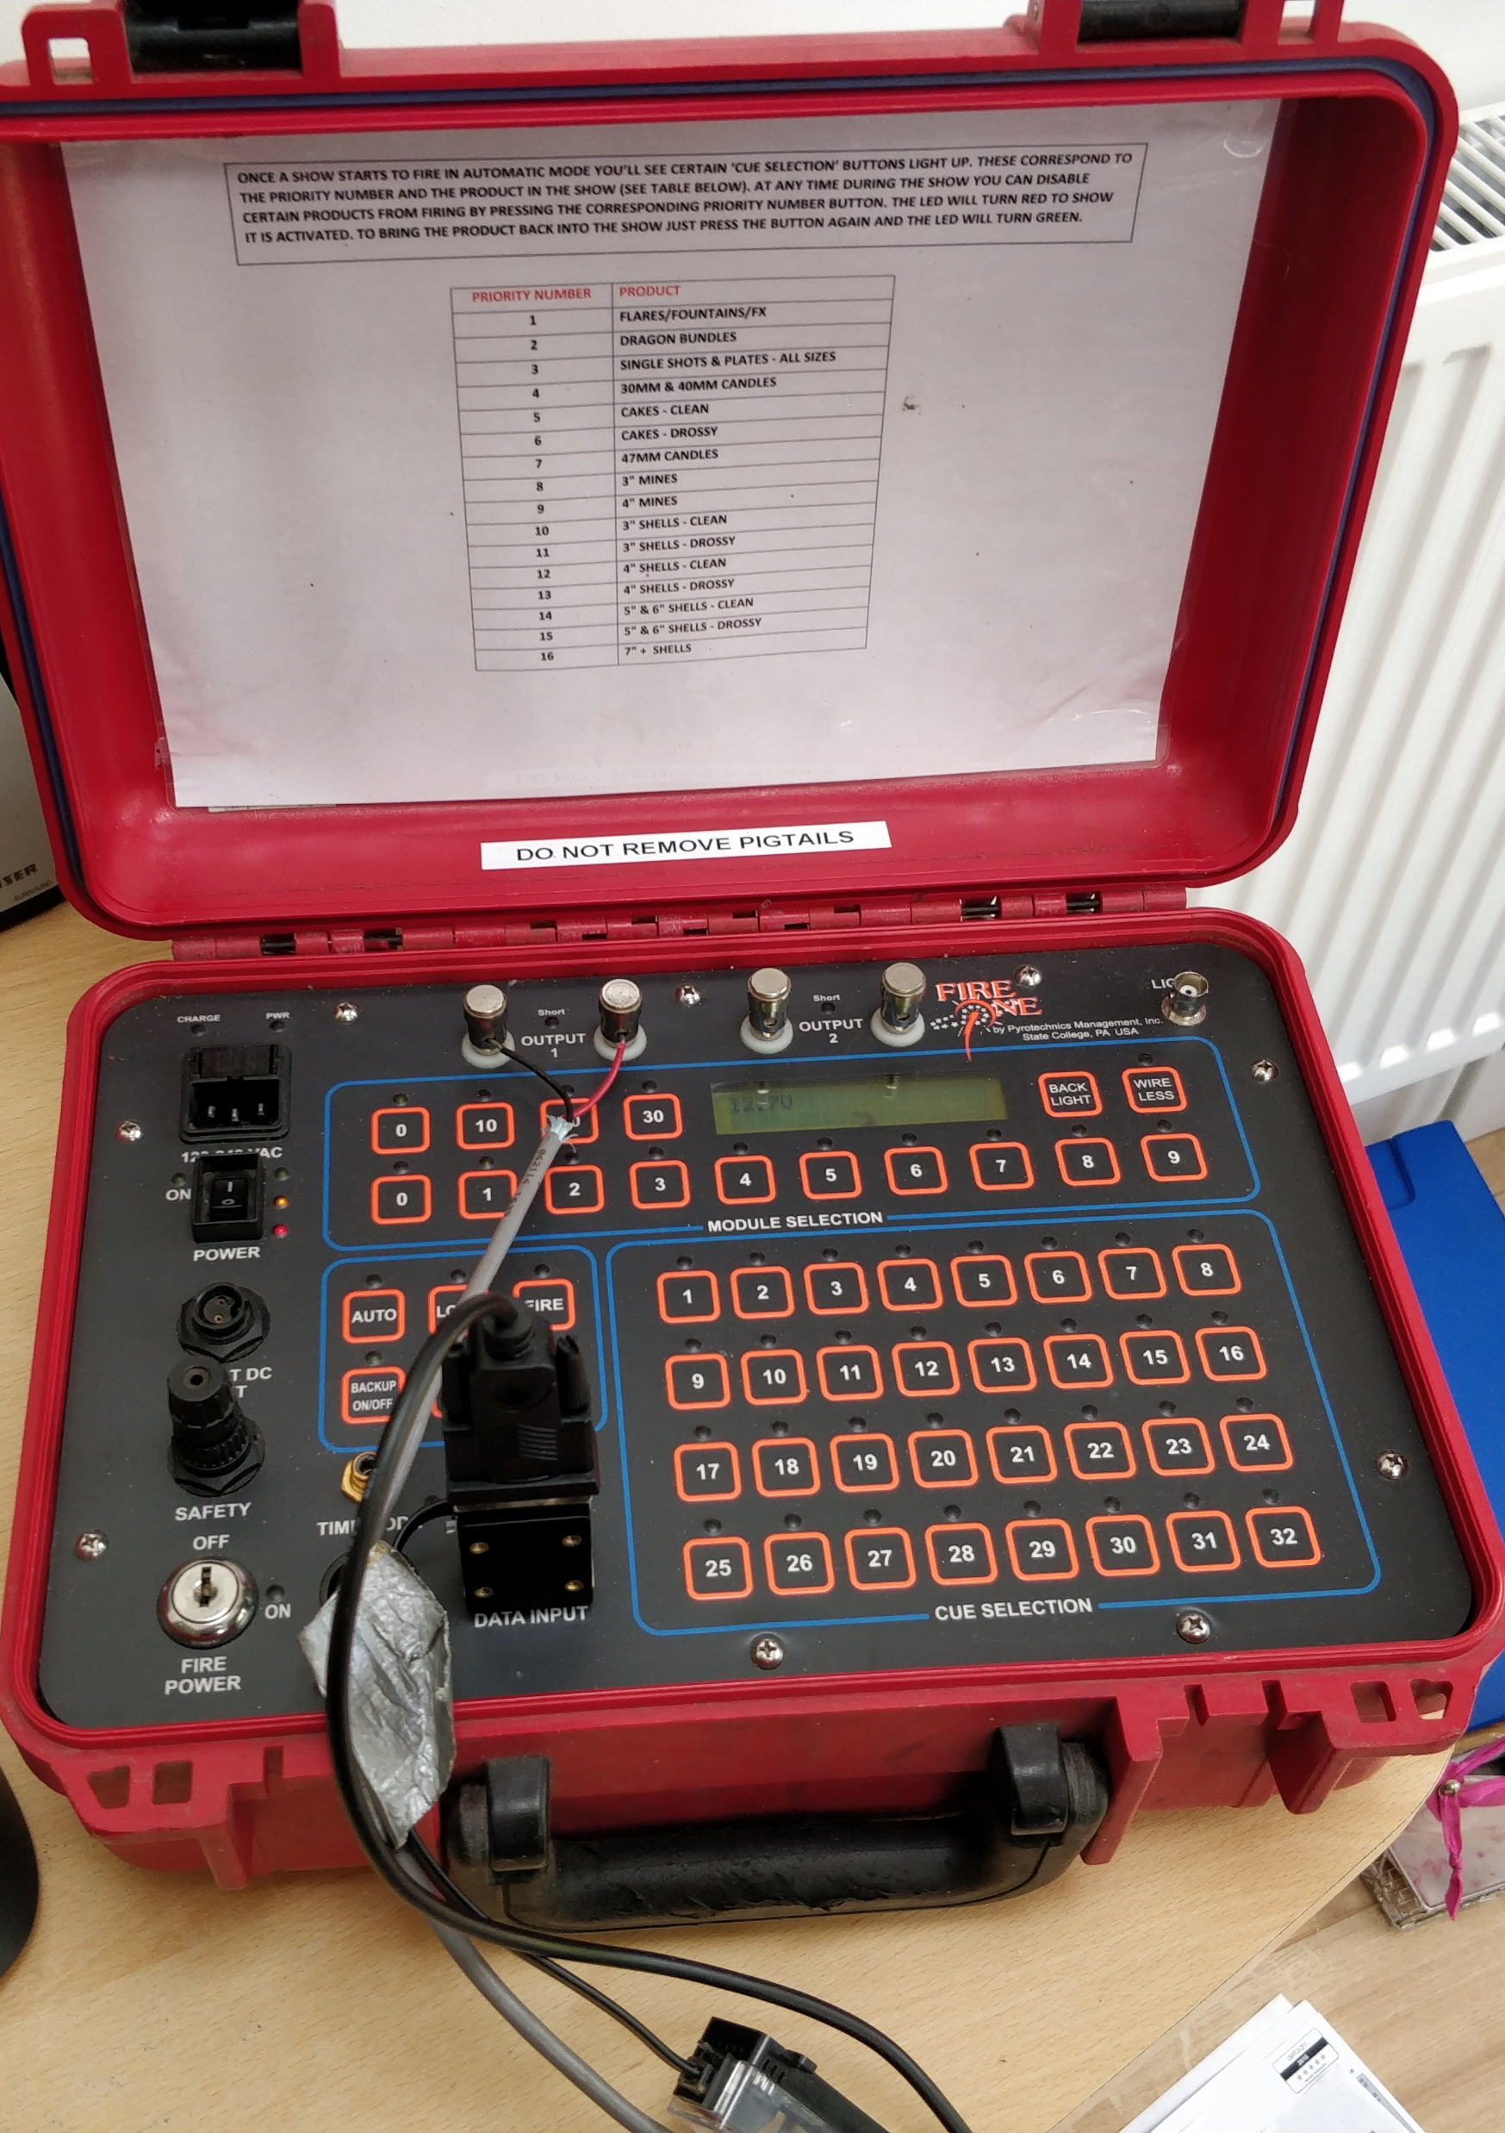
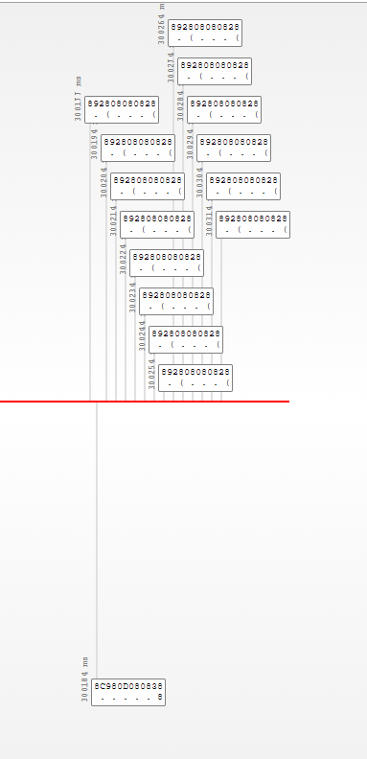
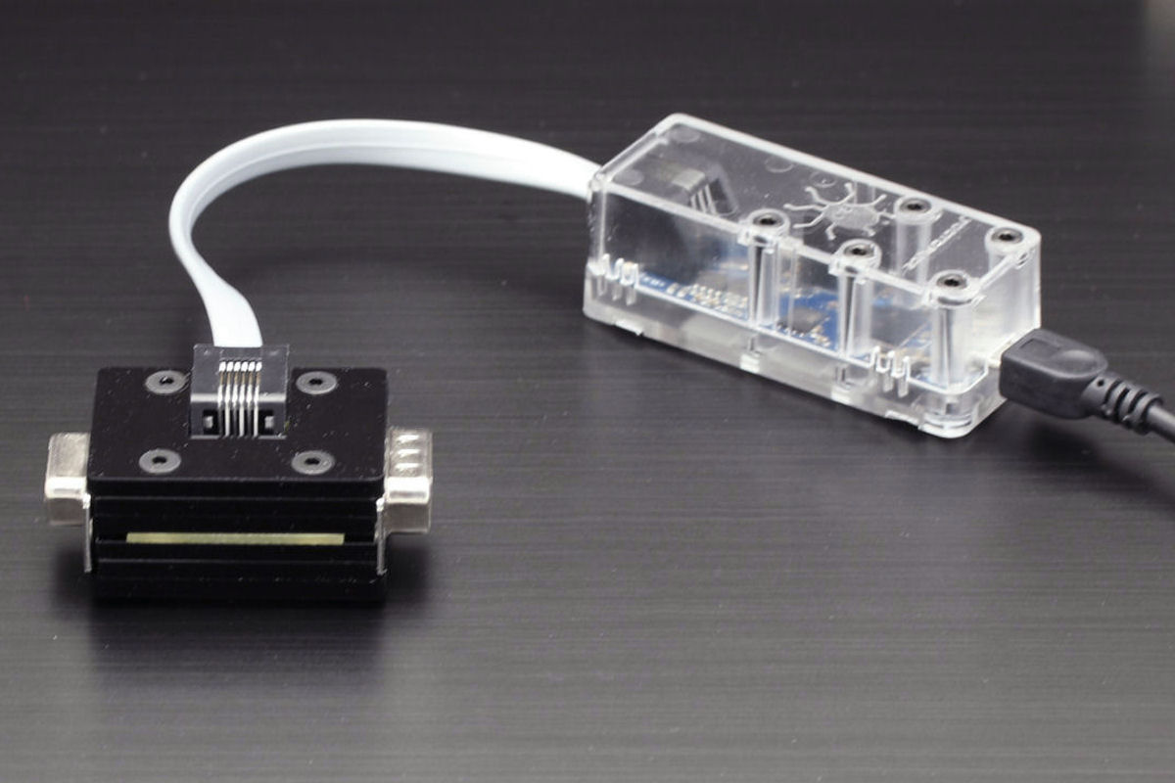
Reverse Engineering
Notes:
Used a yoctopuce RS232 with Serial Adapter
Enables snooping of Serial connections without interfering
Other physical and virtual options were considered but primarily where more expensive or would require control of the original software
Sends data to its own application for visualisation
Can do 1000 other things but didn’t need them
Reverse Engineering
Used the official software to perform actions
Sends a hexadecimal request
Receives a steam of hexadecimal back
Looking for known numbers / increments primarily
Eventually managed to figure out all the main commands and expected responses through a lot of trial and error

Slide 33
Module Requirements
Easy to Iterate and Extend
Private and Public Functions
Easy to Pick up and Use

Slide 34
Module Architecture
Using Module Builder
Using PSFramework
Invoke-Show not a command
Notes:
ModuleBuilder enables Public/Private Functions with an easy and simple compilation process
Shoutout to the ModuleBuilder team – Joel Bennett primarily but others have contributed
PSFramework enables setting persistence between load, very useful for COM management
Also provides a really nice logging framework which works well with individual function testing and compiles nicely with ModuleBuilder
Shoutout to Friedrich Weinmann
Wanted to show an implementation of the module but didn’t want to overly restrict the format
Maintaining as a script enables people to swap out data sources
Avoids a core module dependency on ImportExcel
Consistent with module vs script convention
Timing logic very Dumb and not optimised or accurate

Slide 35
Going Serial
Notes:
Talk through Invoke-Explosion Function
Commands are primarily made up of 12 Byte ‘packets’
Leading into Send-RawData
Accessing COM via c# System.IO.Ports.SerialPort Class
Discuss Checksums and how they work

Slide 36
Takeaways
Most PowerShell has a Kinetic Impact

Slide 37
Takeaways
Most PowerShell has a Kinetic Impact
Modular Modules makes development easier

Slide 38
Takeaways
Most PowerShell has a Kinetic Impact
Modular Modules makes development easier
Build on the shoulders of giants

Slide 39
Takeaways
Most PowerShell has a Kinetic Impact
Modular Modules makes development easier
Build on the shoulders of giants
Have fun learning!

Slide 40
End with a Bang

Slide 41
Q&A
15 minutes

Slide 42


